Slide 1

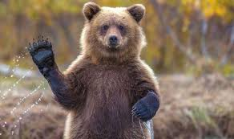
Welcome to the Woods!

Slide 2
Your Connections…
Student Support
Admin
Office Staff
EA’s
The Resource Centre
Counsellors / Youth worker
School Liaison
Career Centre
Families
EAL
Classroom Teachers

Slide 3
Counselling
THE HERITAGE WOODS TEAM:
Principal
Vice-Principals
Todd Clerkson
Jill Reid (A – G)
Manjit Rai (H - N)
Mark Rao (O - Z)
Youth Worker
Shaunna Martin (A - G)
Karen Leeden (H - N)
Curt De Wolff (O - Z)
Karin Leathwood
Career Facilitator
Darilynn Butler
Learning Centre
English Alternate Learner
Pat Vance
(Team Leader)
Angeline Lee
  (Team Leader)

Slide 4
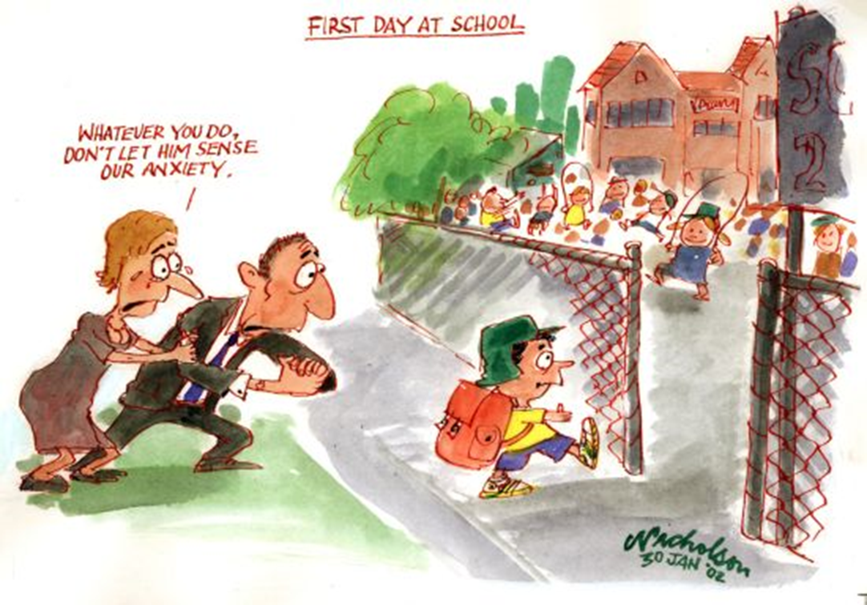

Slide 5

How Things Work:
Two semesters each school year
  Semester 1: Sept-Jan
  Semester 2: Feb-June
Students take 8 courses + digital literacy over 2 semesters
Classes are 72 minutes long
Flex Blocks: Mon-Fri, 30 mins of tutorial time with a teacher (except for the 1st Mon of each Month)
Some students take additional courses outside of the 2-5 block schedule (band, choir, agility)

Slide 6

Bell Schedule…
MONDAY | TUESDAY | WEDNESDAY | THURSDAY | FRIDAY
Block 1 8:00-9:12​ | Block 1 8:00-9:12 | Block 1 8:00-9:12 | Block 1 8:00-9:12 | Block 1 8:00-9:12
Block 2 9:16-10:28 | Block 2 9:16-10:28 | Block 2 9:16-10:28 | Block 2 9:16-10:28 | Block 2 9:16-10:28
FLEX 10:28-10:57 | FLEX 10:28-10:57 | FLEX 10:28-10:57 | FLEX 10:28-10:57 | FLEX 10:28-10:57
Block 3 11:01-12:13 | Block 3 11:01-12:13 | Block 3 11:01-12:13 | Block 3 11:01-12:13 | Block 3 11:01-12:13
LUNCH 12:13-12:53 | LUNCH 12:13-12:53 | LUNCH 12:13-12:53 | LUNCH 12:13-12:53 | LUNCH 12:13-12:53
Block 4 12:57-2:09 | Block 4 12:57-2:09 | Block 4 12:57-2:09 | Block 4 12:57-2:09 | Block 4 12:57-2:09
Block 5 2:13-3:25 | Block 5 2:13-3:25 | Block 5 2:13-3:25 | Block 5 2:13-3:25 | Block 5 2:13-3:25
1st MONDAY OF MONTH (STAFF MEETING)
Block 1 8:00-9:12​
Block 2 9:16-10:28
Block 3 10:32 – 11:45
LUNCH 12:45-12:26
Block 4 12:30-1:43
Block 5 1:47-3:00

Slide 7




Core courses that all students must take:
  English 9 / Recommended EAL from middle school
  Mathematics 9 (Regular or Accelerated)
  Social Studies 9 / Recommended EAL from middle school
  Physical & Health Education 9
  Science 9
  Digital Literacy 10

Slide 8
What is Applications of Digital Literacy 10?
District authorized course run in conjunction with Coquitlam Open Learning
Graduation credits granted upon completion
Concepts of Digital Literacy:
  Digital Footprint
  Using technology to create, collaborate, and communicate
  Plagiarism and Citing Online Sources
  Conducting Relevant Online Searches
  Establishing Personal Learning Networks
Students begin to create Showcase Portfolios of their work here at Heritage Woods

Slide 9
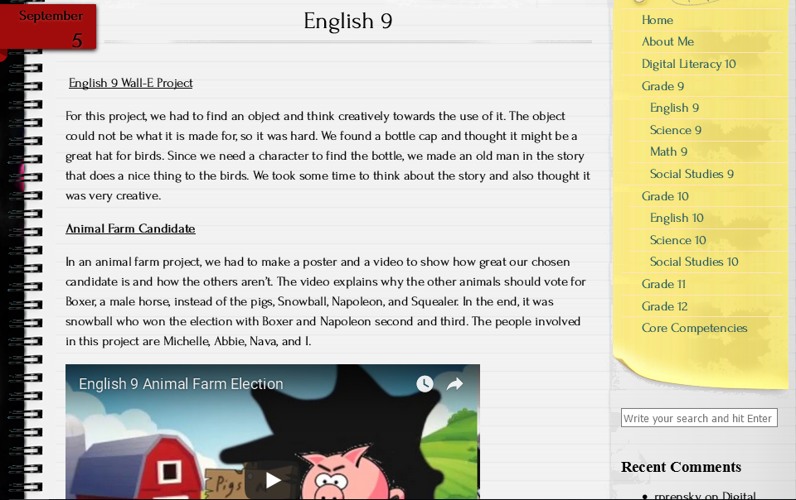
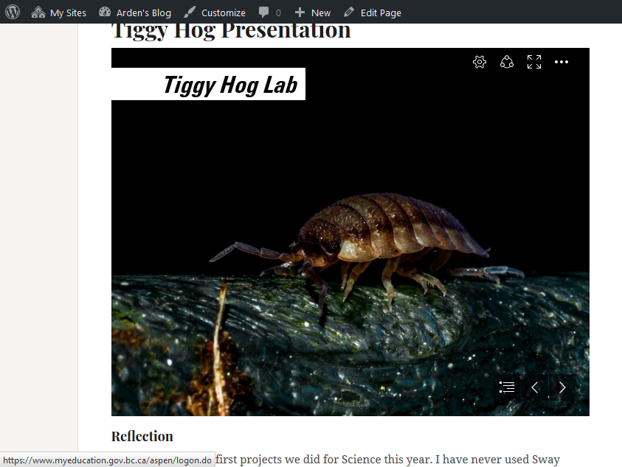
Examples of student work from 1st Semester in English, Science, and Social Studies 9.

Slide 10
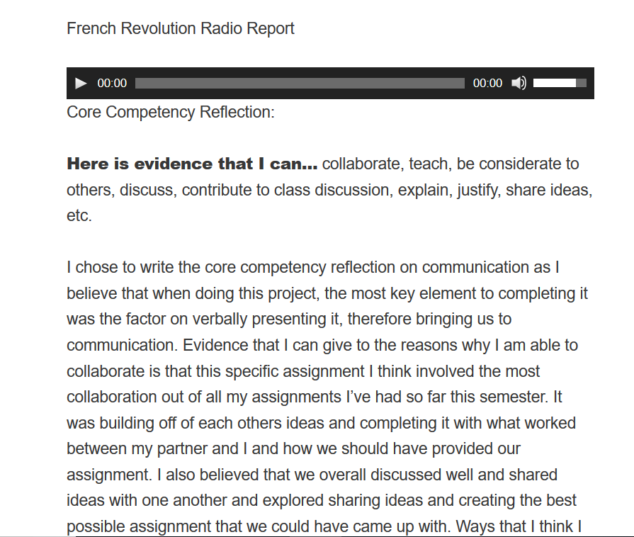
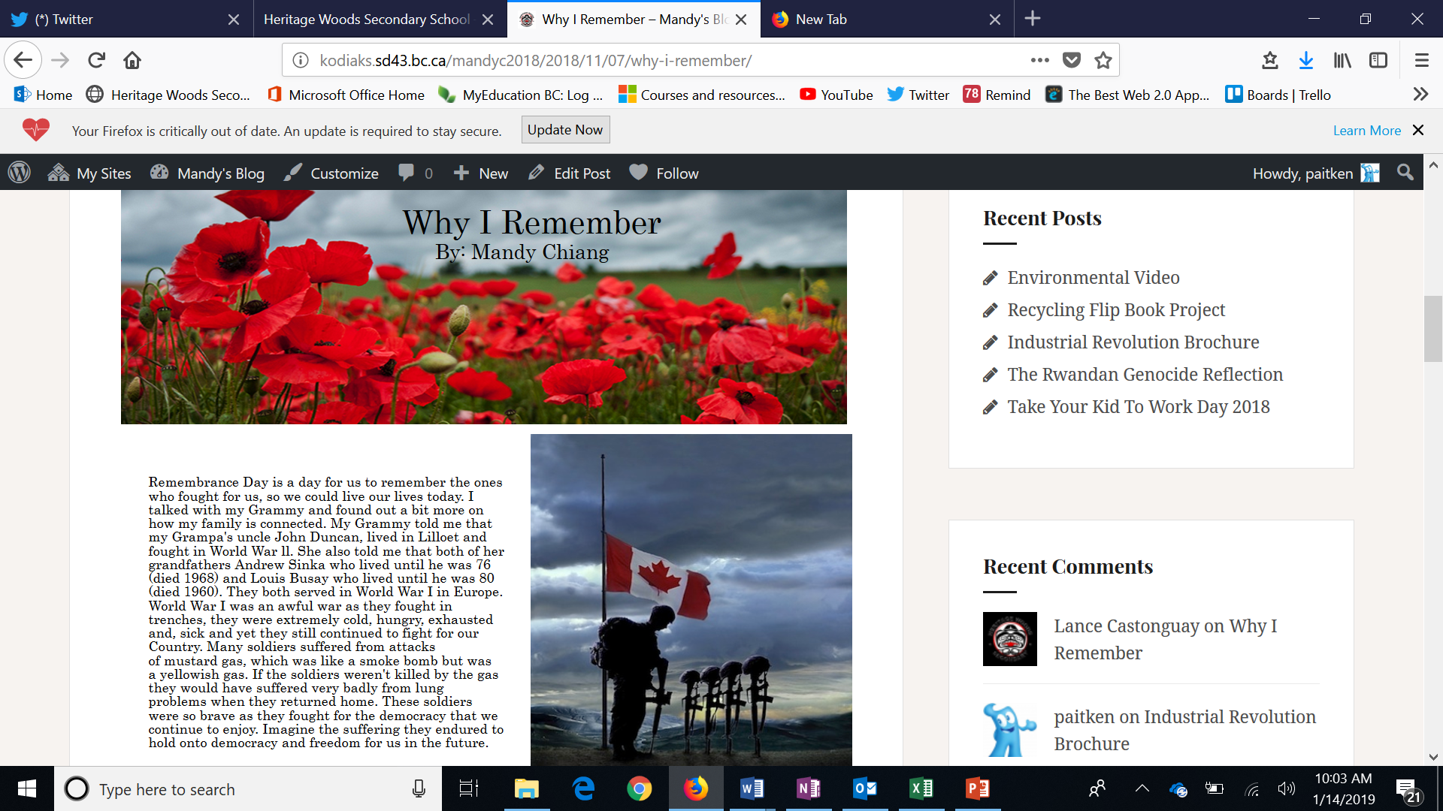
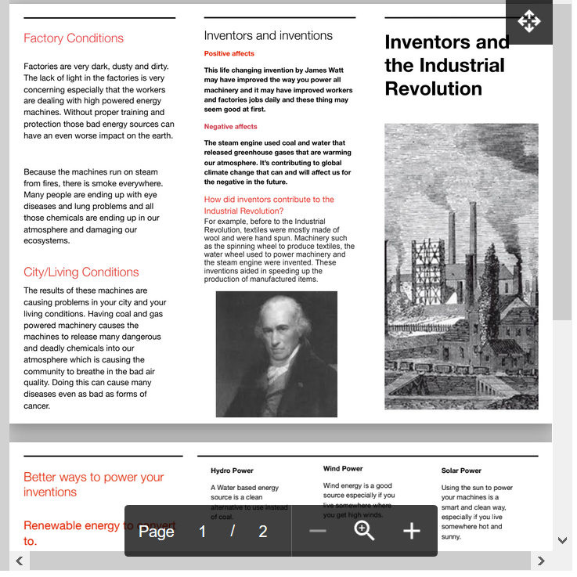
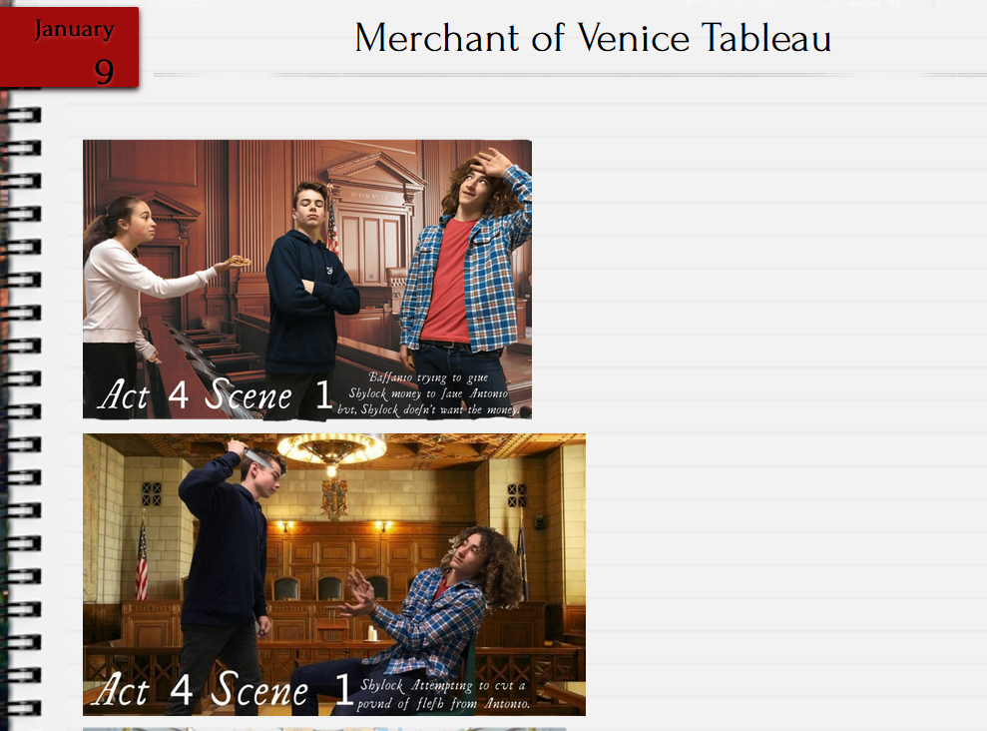
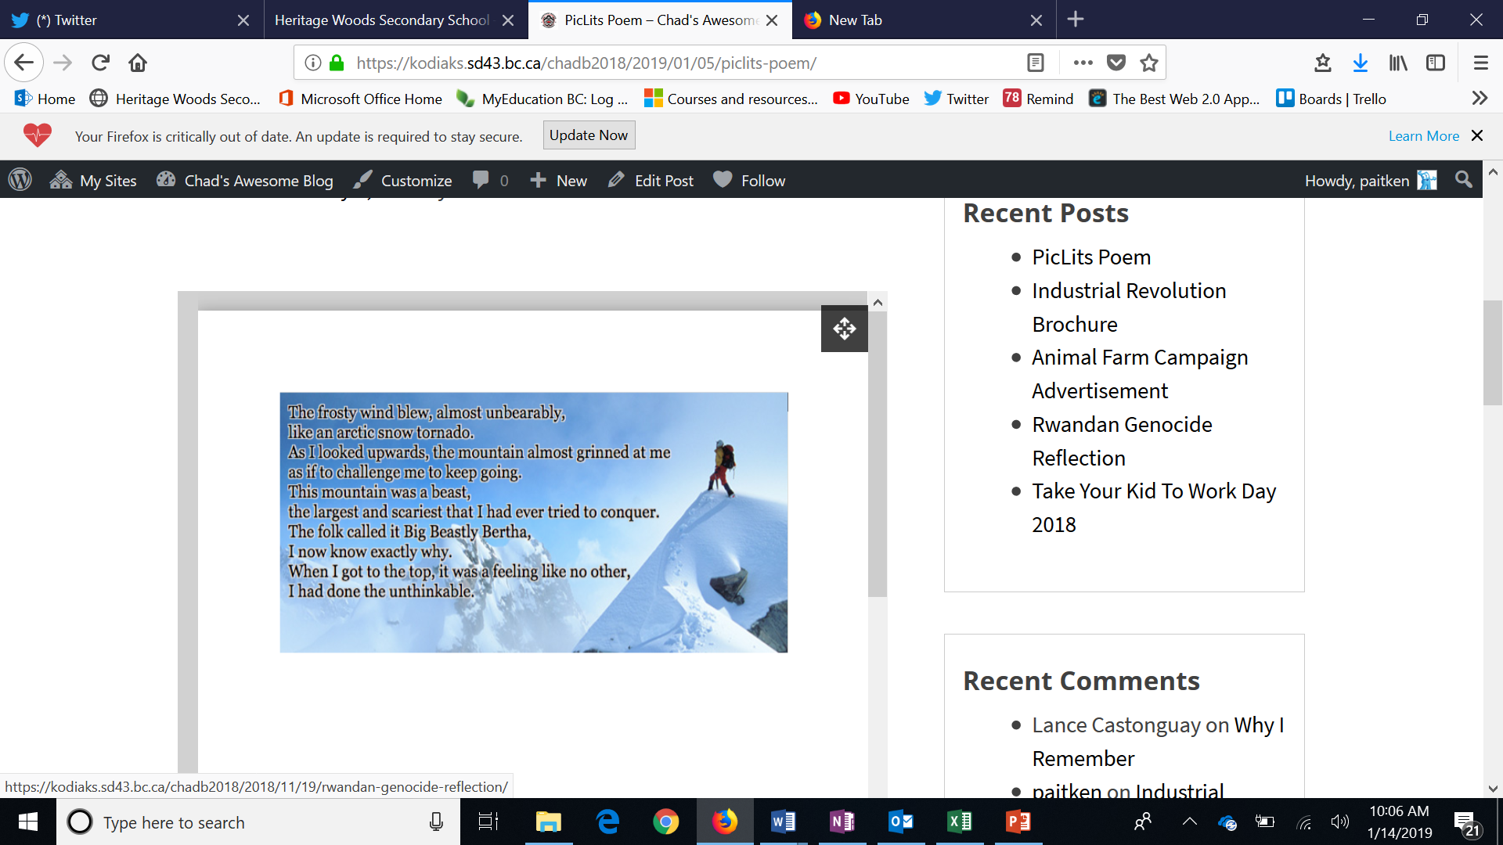
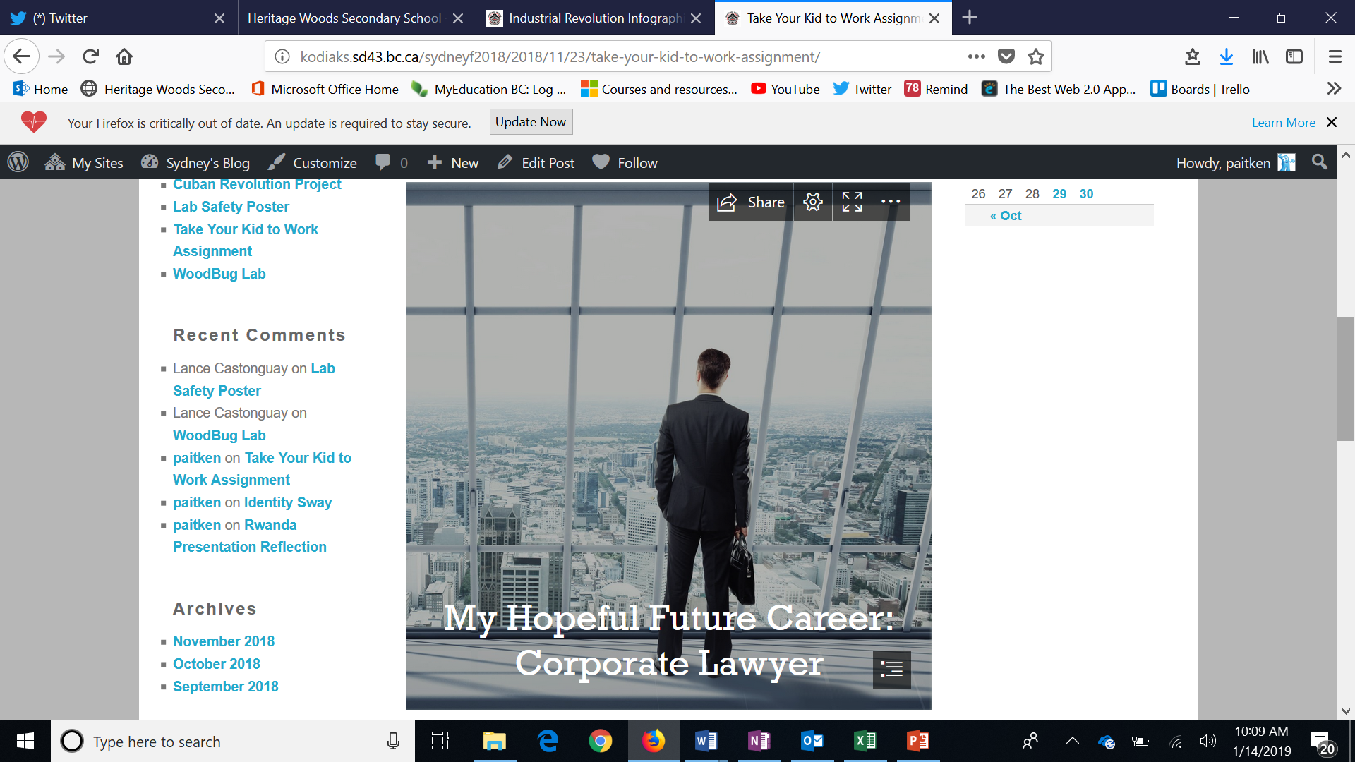

Slide 11
Why Bring Your Own Device?
No papers to lose
Study and work anywhere at any time
Lighter backpack
Access to online resources at all times
Everything on one device (Office 365 Access – Free to SD43 Students)
Ability to collaborate more easily

Slide 12
What are acceptable devices?
Laptop Computers, Tablets, Ipads – Phones are not acceptable devices
Advisable to have laptops as they have more functionality
Devices can be purchased for $300 to $500 (and up) – You do not require a top of the line device to be successful
Don’t pay for Microsoft Programs if buying a laptop – free to SD43 Students. (PC and Mac Versions)
Not all families can afford to purchase a device
The school has some devices available to loan to students for the year – parent release forms available in September

Slide 13

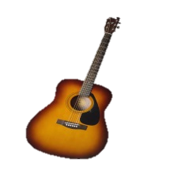


Elective Choices…
Grade 9 students can request 3 electives:
Languages Mandarin, Spanish, Japanese, French
Arts Dance, Art, Hollywood, Photo, Ceramics
Applied skills Info-Tech; Foods; Textiles; Business Ed; Tech Ed – Wood, Drafting, Engineering
Music Guitar
Fitness Fitness Co-Ed, Women’s Fitness
(does not replace PHE 9)
Leadership Leadership

Slide 14
Alternate Courses (2 back-up Electives)
These may be used if it is not possible to have one of their top three elective choices! Therefore, these are JUST AS IMPORTANT.
Outside the Block 2 - 5 Timetable Courses
Many choices including:
Musical Theatre, Weight Training , Agility, Band & Choir!
AM (Before School Hours)
FL (Flex & Lunch)
PM (After School Hours)

Slide 15

Looking Ahead:
Questions about Grade 10-12 programming
Check out the Ministry website for graduation program: https://www2.gov.bc.ca/gov/content/education-training/k-12/support/graduation
Grade 10-12 booklet will also be available online next month
Honours Courses:
  Students entering the honours program from middle school should expect to be challenged by the coursework and will need a strong commitment to their studies
  Math Honours Programs
  English Honours Programs
  AP Calculus
  AP Psychology
Note: Honours designations do not appear on transcripts; AP designation only appears on transcripts of those who pass AP exam
We do NOT offer Honours at the grade 9 level (Accelerated Math 9 only)

Slide 16

Sample Timetable…
Semester 1:
Block 2 - PE 9
FLEX
Block 3 - Science 9
Block 4 - English 9
Block 5 - Photo 9
Concert band 9 linear
Semester 2:
Block 2 - Math 9
FLEX
Block 3 - Social Studies 9
Block 4 - Foods 9
Block 5 - Hollywood 9
Concert band 9 linear

Slide 17



And now a word from our music department…
Ms. Kathy Fester

Slide 18

How Do You Decide?
What you like to do!
Your skills and talents!
Where you excel!
Challenging yourself to try
something new!

Slide 19

Choose Courses Wisely
SPRING 2019
Counsellors will visit feeder middle schools to go over the Grade 9 course selection process and give out the forms:
3 elective requests – in order of preference
2 alternate requests- course options just in case
These are requests – there are many reasons a student may not get their top 3 (course conflicts, class sizes, classes not being offered due to low enrolment)
WE WILL ALWAYS DO OUR BEST TO HELP STUDENTS GET COURSES THAT THEY WILL ENJOY!

Slide 20



Going to High School…
What Should Your Child Expect?
Smaller “team” larger environment
  easier to fly (or swim) under radar
New routines, new clubs / activities, lockers
New friends
More freedom = More responsibility
Different teachers for different subjects

Slide 21




Time is the best gift to give your Teen
Discuss:
How to handle peer pressure
Attendance Expectations
Facing each day positively
Homework expectations, organization, study time at home, goal setting (SMART GOALS – specific, measurable, attainable, realistic, time-based)
Praise and reinforcement
Ask questions (of your teen, teachers, counsellors, & administration)
Learn about and use the resources available
Encourage and support them in getting involved!

Slide 22





There are many ways for them to get involved…
Clubs
Leadership Opportunities
Music
Sports Teams
Intramurals
Volunteering

Slide 23


Stay Connected…
Telephone
Teacher email
Heritage home page
Teacher websites
Counsellor websites
Newsletters
Report cards
Parent nights
Heritage App

Slide 24


How is your child going to make their mark?
Encourage them to get involved
Do what you love & love what you do

Slide 25
Important Dates:
THIS WEEK!!!
Math 9 Accelerated Applications due at their Middle School
February 12th
Counsellors @ Eagle Mountain
March 7th
Counsellors @ Scott Creek
March 8th
Counsellors @ Summit
Jan 25th
Grade 8 “Tour at the Woods” 12:30 - 2:30 pm
Accelerated Math 9 Assessment to follow tour ( 2:45 - 4:45 pm)

Slide 26

General Questions?
For child specific questions please email your child’s counsellor or admin!
Last Names | Counsellor | Admin
A – G | Shaunna Martin smartin@sd43.bc.ca | Jill Reid jreid@sd43.bc.ca
H – N | Karen Leeden kleeden@sd43.bc.ca | Manjit Rai mrai@sd43.bc.ca
O – Z | Curt Dewolff cudewolff@sd43.bc.ca | Mark Rao mrao@sd43.bc.ca
Student Services | Pat Vance pvance@sd43.bc.ca
EAL | Angeline Lee alee@sd43.bc.ca

